Slide 1
AI tool/mobile app for Indian Sign Language (ISL) generator from audio-visual content in English/Hindi to ISL content and vice-versa.
PIP2001 Capstone Project
Review-0
Batch Number:205
Under the Supervision of,
Dr . Abdul Kadhar A
Associate Professor
School of Computer Science and Engineering
Presidency University
Roll Number | Student Name
20211CSE0164 | A Siva Sahithi
20211CSE0884 | K Manoj Kumar
20221LCS0005 | Shreyank Shankar S
Name of the Program: B.Tech
Name of the HoD: Dr. Asif Mohammed
Name of the Program Project Coordinator: Mr. Amarnatha J L, Dr. Jayanthi Kamalasekaran
Name of the School Project Coordinators: Dr. Abdul Khadar A

Slide 2

Content
Problem Statement
Github Link
Analysis of Problem Statement
Timeline of the Project
References

Slide 3
Problem Statement Number:
Organization: Ministry of Social Justice and Empowerment
Category : Software
Problem Description: There is a significant communication gap for the deaf and hard-of-hearing community due to the lack of real-time, automated Indian Sign Language (ISL) translation tools. This project aims to develop an AI-powered tool/mobile application capable of converting spoken and visual content in English/Hindi into ISL and vice versa. The tool will leverage speech-to-text, natural language processing (NLP), computer vision, and deep learning to generate real-time ISL translations, enhancing accessibility for individuals relying on sign language.
Difficulty Level: Simple

Slide 4
Github Link
Github Link -
https://github.com/shreyank2000/AI-tool-for-ISL-generator

Slide 5
Analysis of Problem Statement (contd...)
Problem Understanding :
The problem statement focuses on developing an AI tool or mobile application capable of converting audio-visual content in English or Hindi into Indian Sign Language (ISL) and vice-versa. This solution aims to bridge the communication gap between the hearing-impaired community and the general population.
Key Challenges:
Language Processing: Translating English/Hindi audio or text into ISL, which is a visual-gestural language with its own grammar and structure.
Sign Language Generation: Creating accurate ISL gestures using animated avatars or video-based models.
Speech-to-Text Accuracy: Ensuring high precision in converting spoken language into text before translating it into ISL.
Gesture Recognition (For ISL to Text/Speech): Accurately interpreting ISL gestures from video input and converting them into Hindi/English text/audio.
Real-time Processing: Developing a model that works in real-time for live conversations.
Hardware & Software Integration: Supporting mobile and web platforms with necessary computational power for AI processing.

Slide 6
Analysis of Problem Statement
Technology Stack Components:
Speech Processing: Google Speech-to-Text, Whisper AI
Natural Language Processing (NLP): Transformer-based models, BERT, GPT
Computer Vision: OpenCV, MediaPipe, TensorFlow/Keras
Sign Language Recognition & Generation: LSTM, CNN, Gesture Recognition Models
Backend Development: Python (Flask/Django), Node.js
Frontend Development: React Native (for mobile app), HTML/CSS/JS (for web app)
Database: Firebase, PostgreSQL
Cloud Services: AWS, Google Cloud, Azure (for deployment & scaling)

Slide 7
Analysis of Problem Statement (contd...)
Software and Hardware Requirements:
Software Requirements:
Python, TensorFlow/Keras, PyTorch
OpenCV, MediaPipe
Google Speech API, Whisper AI
Flask/Django for backend
React Native for mobile UI
Firebase/PostgreSQL for database
Hardware Requirements:
GPU-enabled system for AI model training
Smartphones/Tablets for real-time testing
Camera-enabled devices for gesture recognition

Slide 8
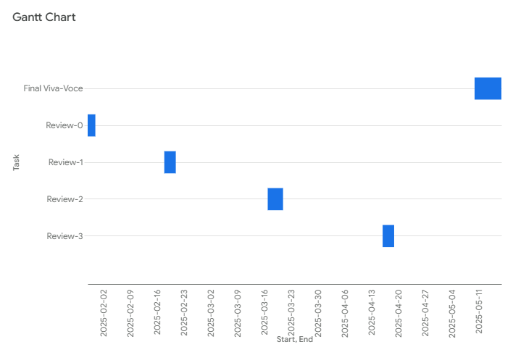
Timeline of the Project (Gantt Chart)
Timeline:

Slide 9
References (IEEE Paper format)
[1] A. Graves, "Generating Sequences With Recurrent Neural Networks," arXiv preprint arXiv:1308.0850, 2013.
[2] J. Devlin, M. Chang, K. Lee, and K. Toutanova, "BERT: Pre-training of Deep Bidirectional Transformers for Language Understanding," arXiv preprint arXiv:1810.04805, 2018.
[3] A. Vaswani et al., "Attention Is All You Need," in Advances in Neural Information Processing Systems (NeurIPS), 2017.
[4] F. Chollet, Deep Learning with Python, 2nd ed. Shelter Island, NY, USA: Manning Publications, 2021.
[5] K. Simonyan and A. Zisserman, "Very Deep Convolutional Networks for Large-Scale Image Recognition," arXiv preprint arXiv:1409.1556, 2014

Slide 10


